Slide 1

WELCOME
TO
POWERPOINT PRESENTATION

Slide 2

COMPUTER FUNDAMENTALS (Lab)
PREPARED BY:
HARIS KHAN
ETEA ID:60032
SHAFIQUE QURESHI
ROLL NO:41
SECTION:
“A”
DATE:
23/01/2023
TOPIC:
COMPUTER GRAPHICS

Slide 3
COMPUTER GRAPHICS
BASIC TERMINOLOGIES:
Pixel
Resolution
PPI (Pixel Per Inch)
Aspect ratio
Frame buffer

Slide 4
WHAT IS COMPUTER GRAPHICS?
Computer graphics is an art of drawing image on computer screen using programming language.
It involves creation, manipulation of data.
It is a rendering tool for generation and manipulation of image.
The first computer graphics design system was developed by “Evan Sutherland” in 1963.

Slide 5
APPLICATIONS OF COMPUTER GRAPHICS
CAD (Computer Aided Design)
Visualization
Presentation Graphic
COMPUTER GRAPHICS
Entertainment
Education and training
Computer art
Image processing

Slide 6
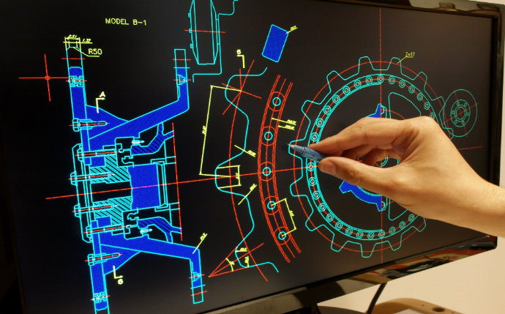
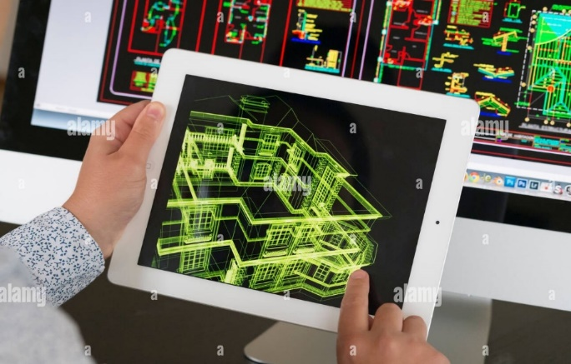
Computer Aided Design (CAD)
Introduced in 1957
Computer Aided Design (CAD) is a type of computer based tool used for drafting and designing.
CAD is useful in various designing field such as architecture, mechanical and electrical automobiles, aircrafts etc.
Types of CAD
2D CAD
2.5D CAD
3D CAD
3D wireframe
Solid modelling

Slide 7
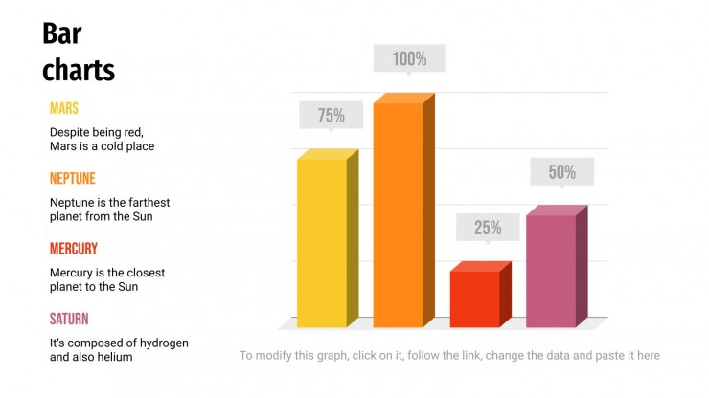
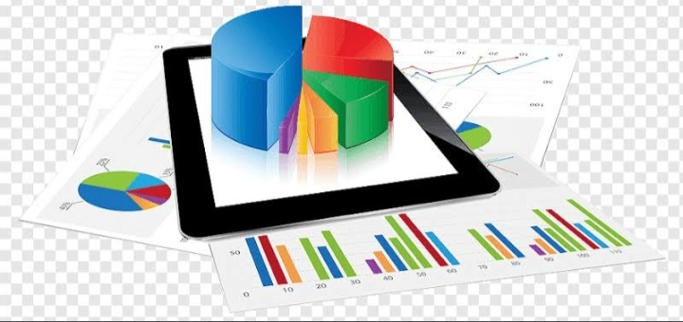
Presentation Graphic
An image designed to visually enhance a presentation.
Can be used in electronic slide shows, as well as in printed reports.
Presentation graphic is used to summarize financial, statistical, mathematical, scientific data for research reports and other types of reports.
Typical examples:
Bar charts, line graph, surface graph, pie chart etc.

Slide 8
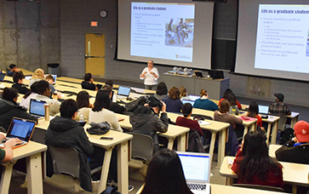

Education and Training
Computer graphical technique is used in education and training.
Computer generated models of physical, financial and economics system are often used, which can help trainees to understand the operation of system.
Useful for teaching huge number of concepts and fundamentals in an easy to understand and learn manner.
Using computer graphics many educational models can be created through which more interest can be generated among the students regarding the subject.

Slide 9
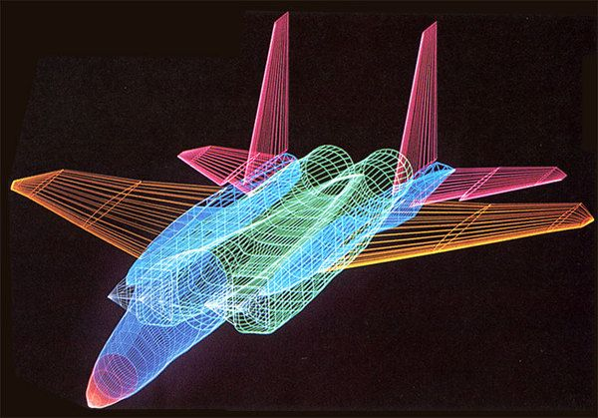
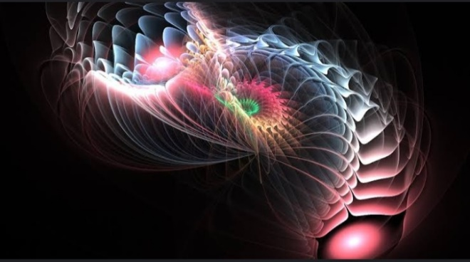
Computer Art
Computer graphics method are widely used in both fine art and commercial art application.
Artists use a variety of computer methods including special purpose hardware artists paint brush programs specially developed software, symbolic mathematics packages.
To generate images.
Manipulation of computer-generated images (pictures, designs, scenery, portraits etc.) as part of purposeful creative process.

Slide 10
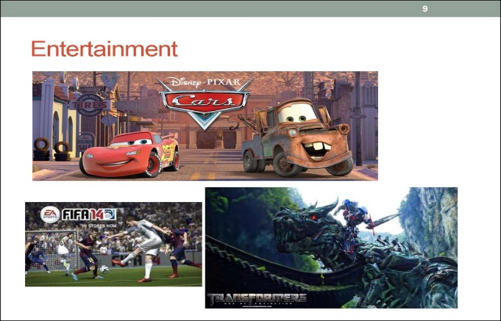
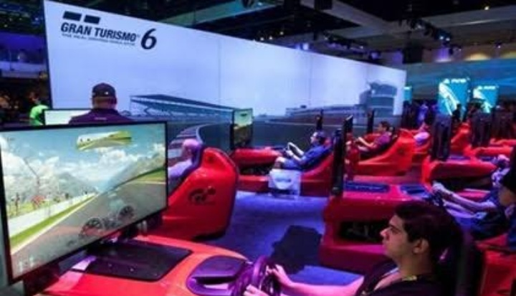
Entertainment
Computer graphics method are now commonly used in making motion pictures, music videos and television shows.
Computer graphics are used regularly in many movies, TV series for generating some graphics scene.
Most modern films are done in 3D computer generated animation.

Slide 11
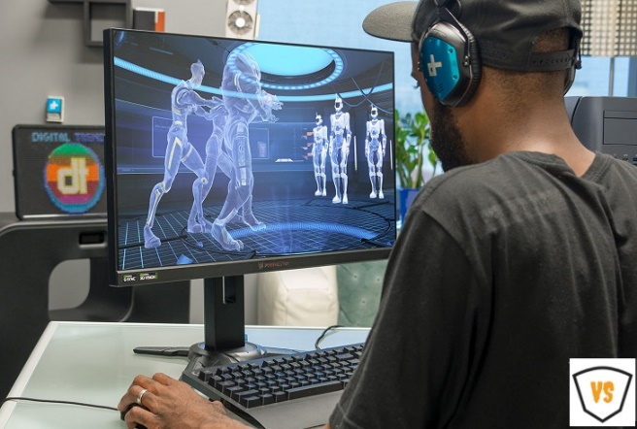
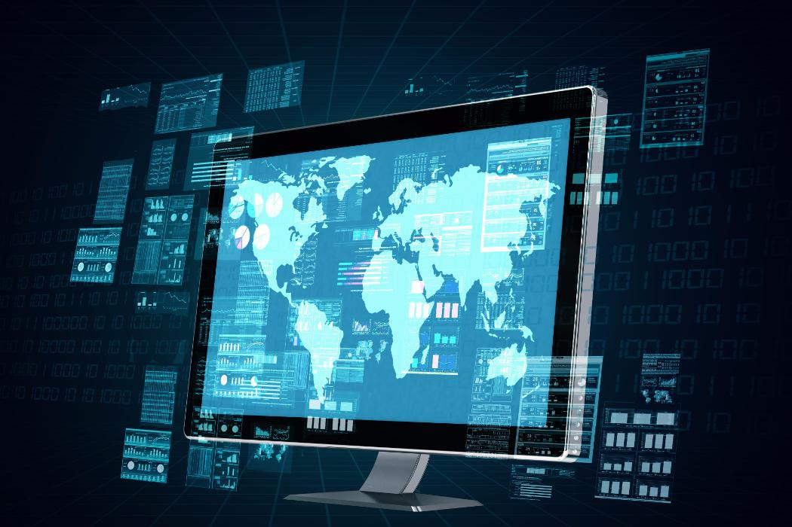
Image processing
Processing image of existing images into refined ones for better interpretation is one of the many application of computer graphics.
Performing operation on an image in order to get an enhance image or to extract some useful information from it.
It perform operation on image like rotation and blurriness.

Slide 12
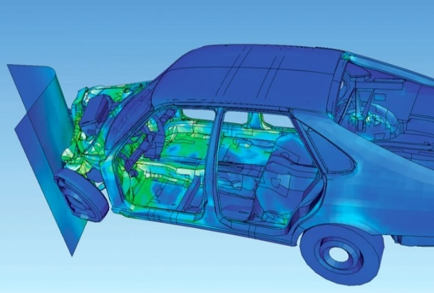
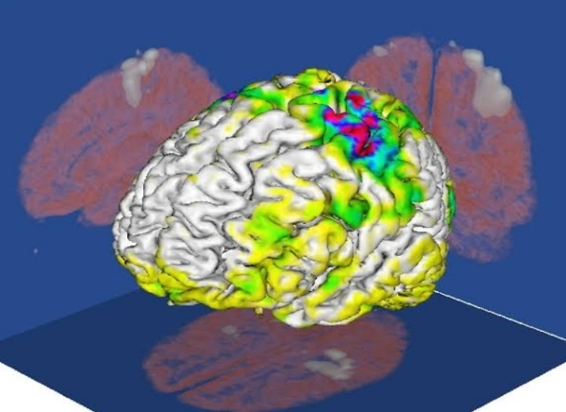
Visualization
It is the process of representing data graphically and interacting with these representation in order to gain insight into data.
Producing graphical representation for scientific engineering and medical data sets.
Scientist, engineers, medical personal, business analysis and other often need to analyze large amount of information.

Slide 13



